Slide 1

WELCOME

Slide 2
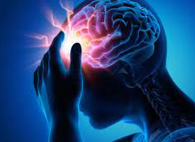
Brain Stroke Disease Classification

Slide 3
Group Members
Name
Roll Numbers
Srushti Birajdar
Pratiksha Mane
Dhanashri Patil
Poonam Patil
Pratibha Sawant
19UCS301
19UCS307
19UCS311
19UCS312
19UCS313
Under the Guidance of:
Prof.S.J.Murchite

Slide 4
CONTENT
Abstract
Introduction
Background study and literature overview
Requirement Analysis
System Design
Implementation
Integration and testing
Performance Analysis
Future Scope
Application
Industry Guidance
References

Slide 5
ABSTRACT
A stroke is a medical condition in which poor blood flow to the brain results in cell death. It is nowadays a leading cause of death all over the world. If we improve the image quality of CT scans of stroke patients and also applying machine learning algorithms to classify the patient’s images into two sub-types of stroke disease then it will helpful in treatment of patient. We have collected a good number of brain images and used four machine learning algorithms to detect the type of stroke.

Slide 6
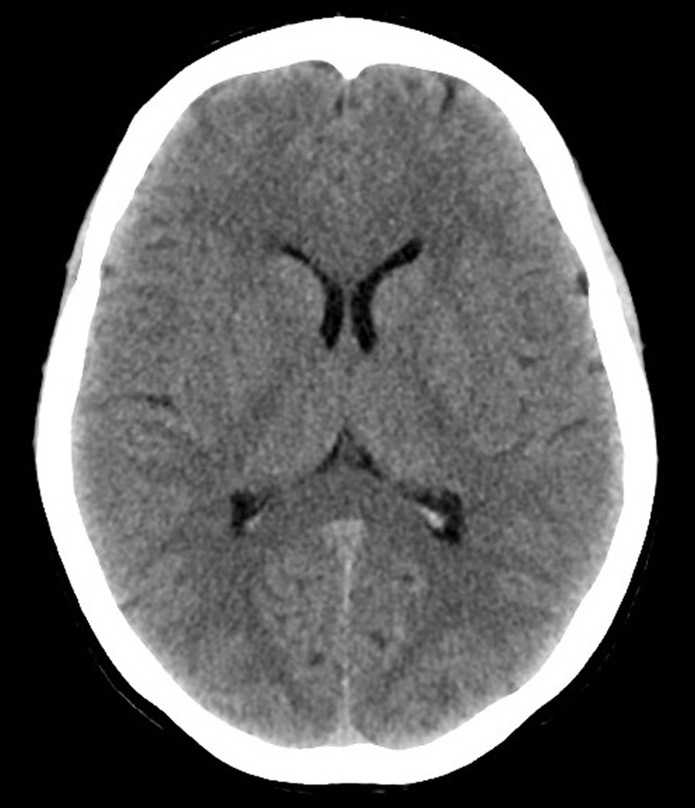
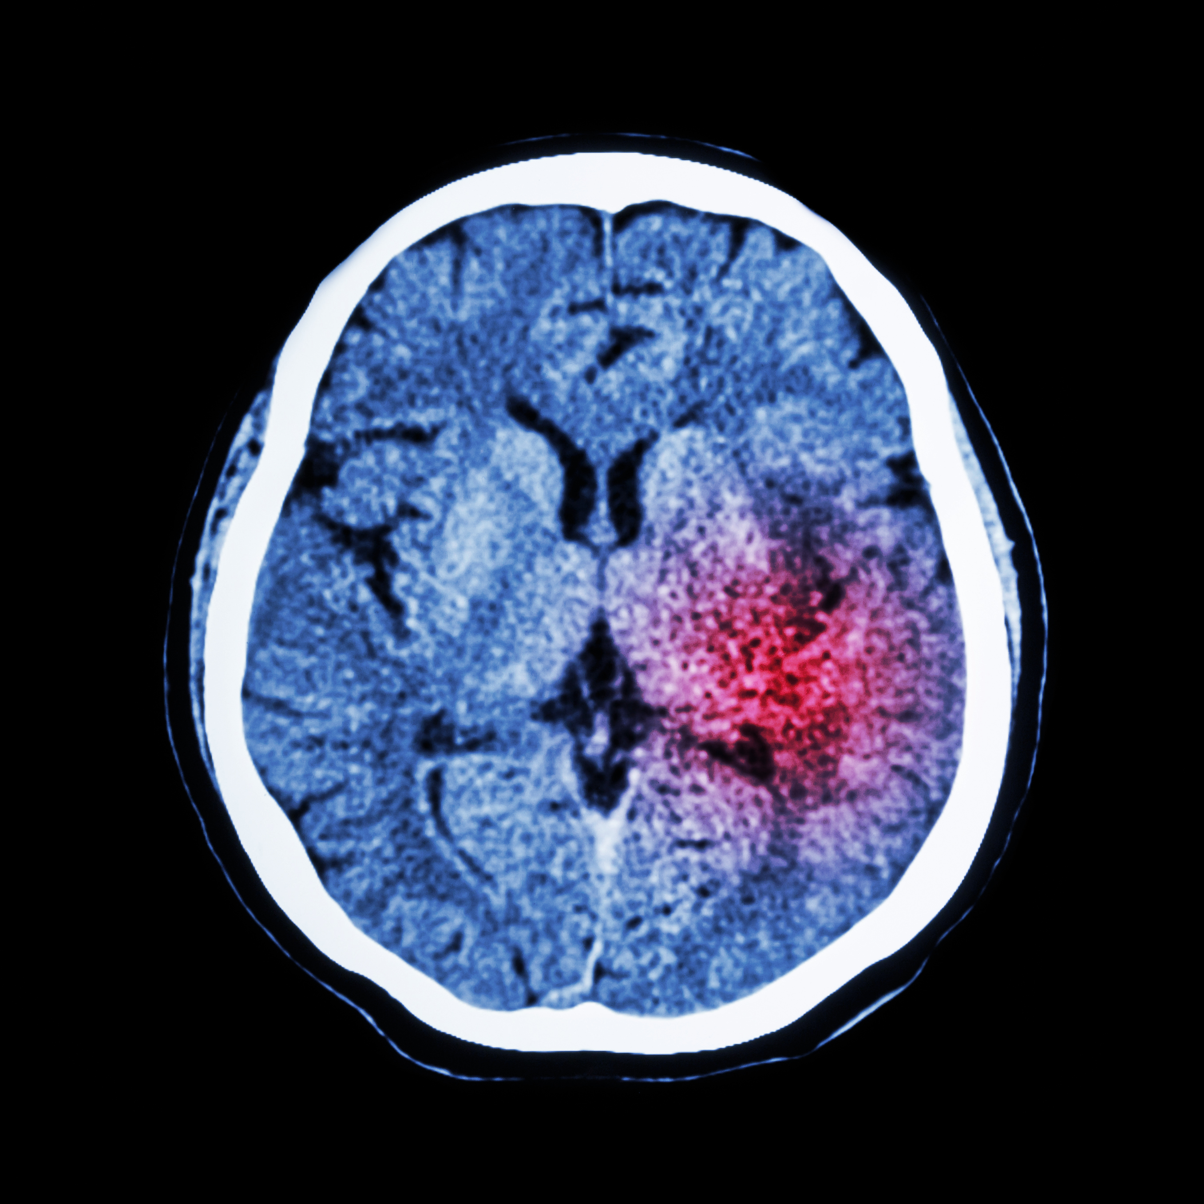
INTRODUCTION
A stroke occurs when the blood supply to part of your brain is interrupted or reduced, preventing brain tissue from getting oxygen and nutrients. Brain cells begin to die in minutes.
There are two types of strokes:
Ischemic stroke -It happens when the brain's blood vessels become narrowed or blocked, causing severely reduced blood flow.
Hemorrhagic stroke – It occurs when a blood vessel in your brain leaks or ruptures. Brain hemorrhages can result from many conditions that affect your blood vessels.

Slide 7
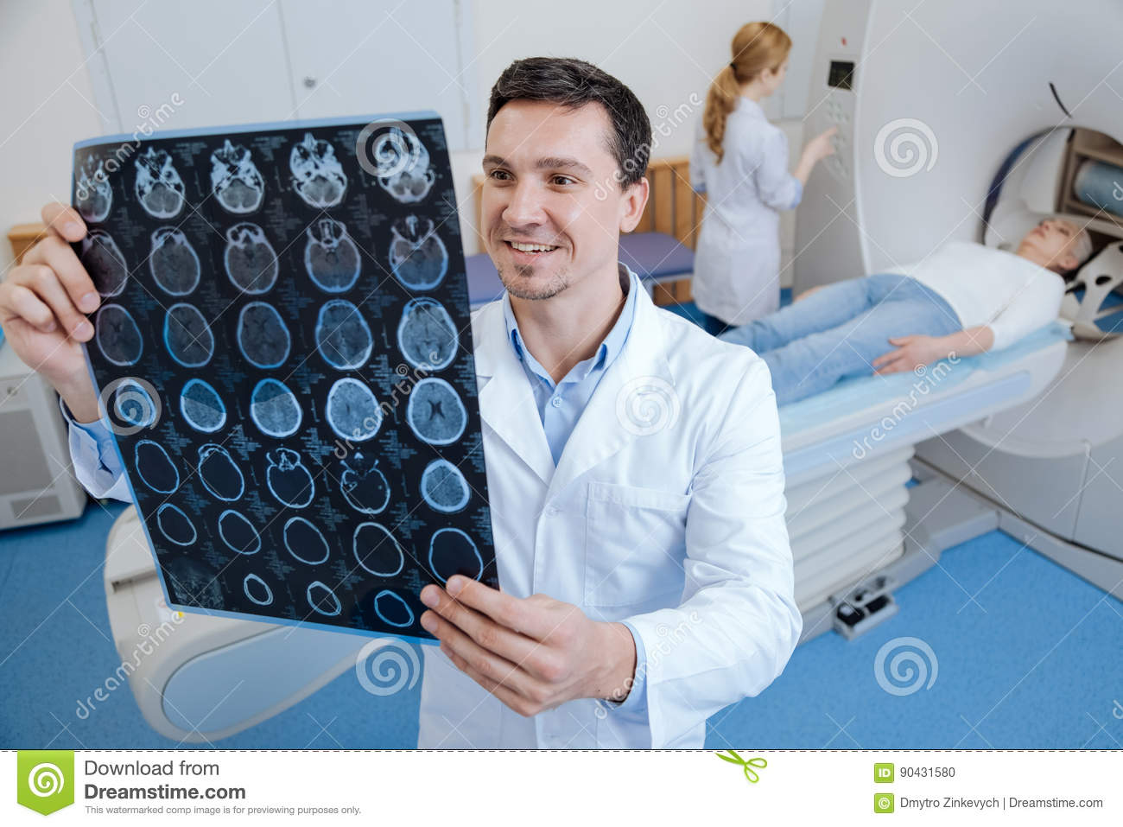
PROBLEM STATEMENT
Design and development of a Brain Stroke Disease Classification System. This system facilitates the work of doctors and technicians, as classification has traditionally been done manually.

Slide 8
PROBLEM DESCRIPTION
In older days some technique are used to detect those disease which will take more time to detect disease but, by using our system we can easily detect disease. This study preprocessing data to improve the image quality of CT scans of stroke patient by optimizing the quality of image to improve image results and to reduce noise, and also applying machine learning algorithms to classify the patient’s image.

Slide 9
OBJECTIVE
To minimize the use of instruments which is needed for stroke disease and make it affordable.
To develop the model for improving accuracy.
To extract features from images.
To perform some operation on an image for enhancing the classified image.

Slide 10
RELATED WORK
Computer Methods and Programs in Biomedicine - The Purpose of this paper was Calculation of 10-year stroke prediction probability and classifying the user's individual probability of stroke into five categories.
Probability of Stroke: A Risk Profile from the Framingham Study - In this paper, A health risk appraisal function has been developed for the prediction of stroke using the Framingham Study cohort

Slide 11
RELATED WORK
Stroke prediction using artificial intelligence- In this paper, Here, decision tree algorithm is used for feature selection process, principle component analysis algorithm is used for reducing the dimension and adopted back propagation neural network classification algorithm, to construct a classification model
Stroke disease prediction using Ct scan image-[IEEE Conference Paper] - In this, they have implemented a stroke disease prediction using Ct scan image dataset of patients with the help of various algorithms like KNN, naive bayes, logistic regression, etc.

Slide 12
REQUIREMENT ANALYSIS
3.1 Requirement Gathering
1. As a user, I want to upload CT scan image of brain, to check whether Stroke is present or not. So that I can get an early treatment as soon as possible.
2. As a user, after uploading an image of the brain, I would like to see if the brain is healthy or ill. After knowing if a stroke present, we can treat it faster
3. As a user, I want to see what kind of stroke I have, know if I have a stroke, and then check the affected area of the brain.

Slide 13
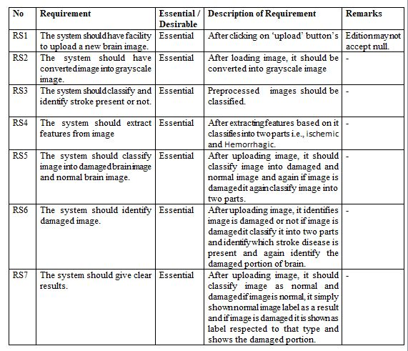
REQUIREMENT ANALYSIS
3.2Requirement Specification

Slide 14
SYSTEM DESIGN

Slide 15
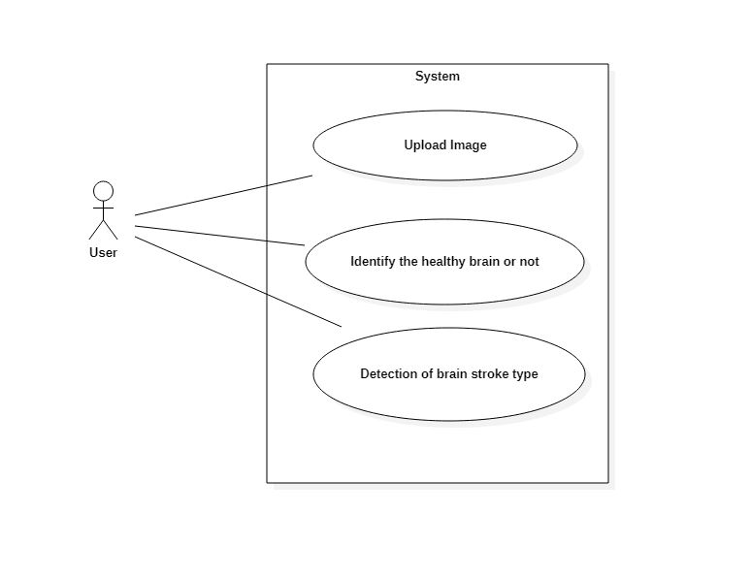
Use Case Diagram

Slide 16
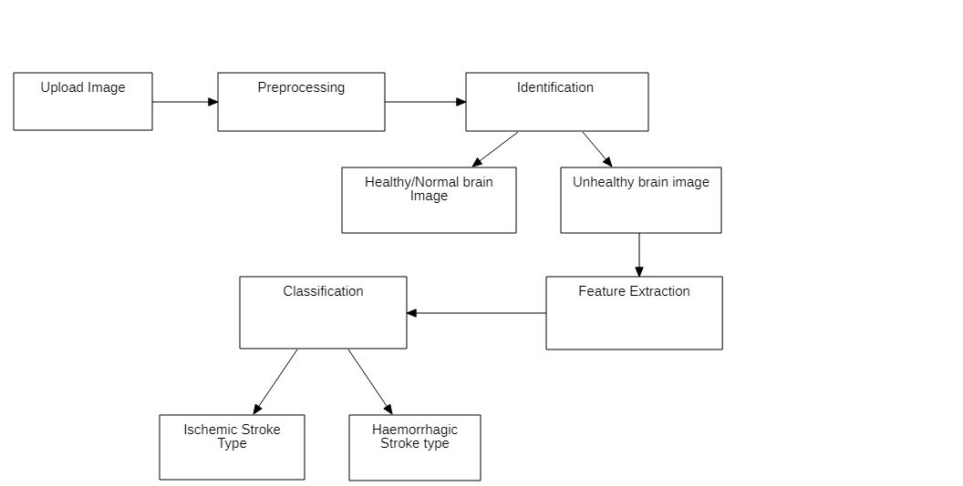
ARCHITECTURE DIAGRAM

Slide 17
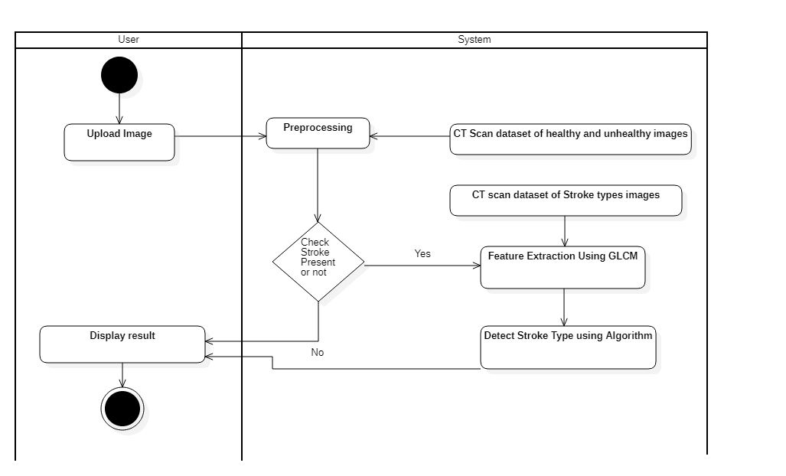
ACTIVITY DIAGRAM

Slide 18
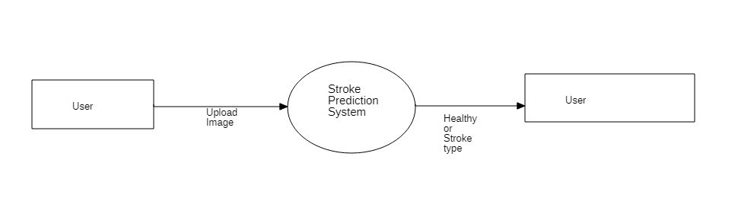
DATA FLOW DIAGRAM

Slide 19
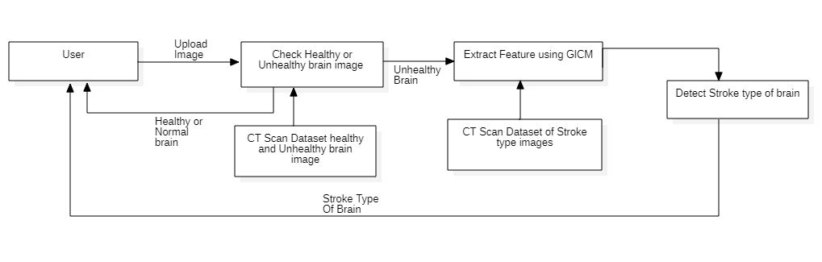
DATA FLOW DIAGRAM

Slide 20
IMPLEMENTATION

Slide 21
ALGORITHMIC DESCRIPTION
1. Data augmentation
Input: Dataset of brain images
Output: augmented images of 1000 of each type
Steps:
1. Start
2. Import keras.preprocessing.image Library
3. Initialize the imageDataGenerator class and pass the augmentation
parameter like rotation_range, zoom_range in the constructor.
4. Generate the image and save it in folder you want.
5. End

Slide 22
ALGORITHMIC DESCRIPTION
2. Greyscale Conversion
Input: Brain image
Output: Greyscale Brain image
Steps:
1. Start.
2. Import Image from PIL(Python Imaging Library).
3.Give image as an input to convert () function to grayscale the image.
4. End

Slide 23
ALGORITHMIC DESCRIPTION
3.Classification using CNN
Input: Dataset of Greyscale Brain images
Output: Model which identify stroke is present or not
Steps:
1.Start
2.Import sklearn, keras, skimage Libraries for preprocessing and CNN.
3. Perform following operations to Preprocess the images
3.1. Convert images to array
3.2. Convert the image labels into integers
3.3. Use to_categorical () function to convert integers to binary class matrix.
3.4. Normalize the image data by dividing 255.0

Slide 24
ALGORITHMIC DESCRIPTION
4. Build the model by adding following CNN layers using add () function.
4.1. Conv2D(32, kernel_size=(3, 3), strides=(1, 1), input_shape=input_shape)
4.2. Activation('relu').
4.3. MaxPooling2D(pool_size= (2, 2)).
Add these layers three times just changing the filter parameter of Conv2D function.
4.4. Flatten()
4.5. Dense(num_classes, activation='sigmoid')
5. Use the adam optimizer and give this optimizer as a input to compile () function and use loss () function as binary_crossentropy.
6. Use fit function for training the model and give input to this function as training data.
7. Stop

Slide 25
ALGORITHMIC DESCRIPTION
4. Feature Extraction:
Input: Dataset of Hemorrhagic and ischemic brain images
Output: Dataset of Extracted features
Steps:
1. Start.
2. Import graycomatrix,graycoprops from skimage.feature libraries.
3. Use the graycomatrix(image) functionand give image as input.
4. Get all the features by using graycoprops() function.
5. Save all the features in dataframe.
6.Save the dataframe as csv file using to_csv() functions.
7. End.

Slide 26
ALGORITHMIC DESCRIPTION
5.Classification using Random Forest algorithms:
Input: Dataset of Extracted Features
Output: Model which identify type of stroke
Steps:
1. Start.
2. Import random forest classifier from sklearn library from sklearn ensemble import RandomForestClassifier.
3. Create a Random Forest Classifier using a RandomForestClassifier() class.
4. Train the model using the training dataset using fit() function.
5. End

Slide 27
INTEGRATION AND TESTING

Slide 28
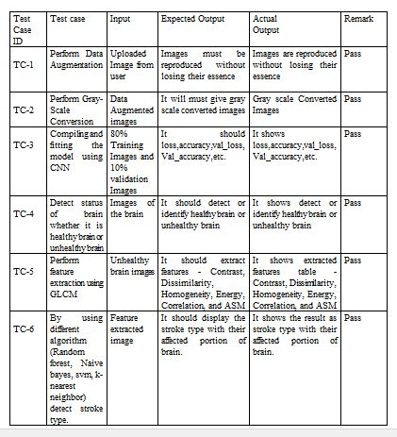
UNIT TESTING

Slide 29
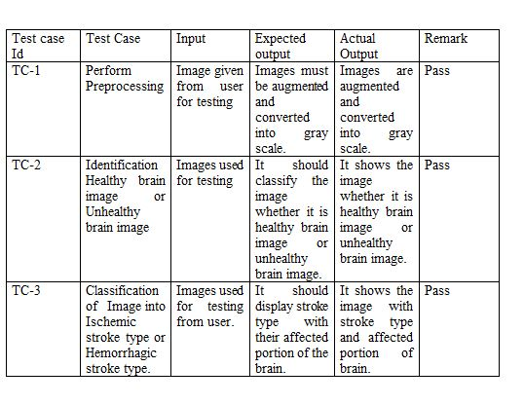
INTEGRATION TESTING

Slide 30
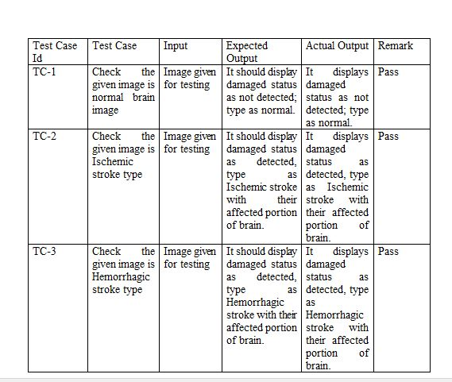
SYSTEM TESTING

Slide 31
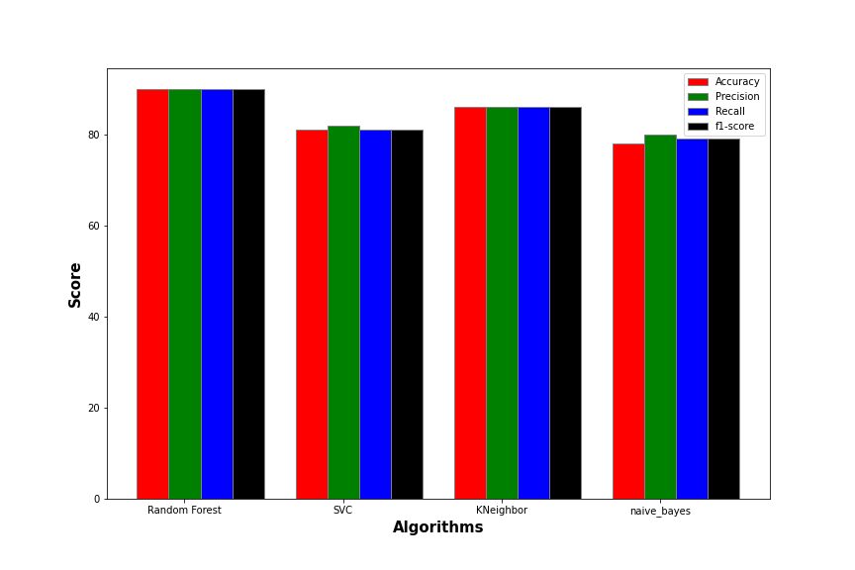
PERFORMANCE ANALYSIS

Slide 32
FUTURE SCOPE
1. Android application of brain stroke disease detection can be built.
2. Project can be extended upto getting more information about Hemorrhagic and Ischemic stroke with their different stroke type.
3. Web application of Brain stroke classification can be launched so that user can reach upto it easily.
4. We can extend project by combining with pressure detection project so that the system can predict the future possibility of stroke occurrence to patient by considering blood pressure and other functionalities of human body.
5. The feature of suggesting the basic common precautions to patient about stroke disease. Also, if stroke detected, system will suggest expert doctors to get treatment of stroke.

Slide 33
APPLICATION
1. Non-Technical person can use and understand easily.
If a non-technical person has a CT scan of the brain, the system can also be used to determine if a stroke has occurred. The system has a user-friendly GUI, which makes it easy to operate the system.
2.In the Hospitals:
In existing systems, doctors manually analyze CT scan images to determine if a stroke is present. However, this existing system can be very time consuming if you need to analyze multiple CT images. In this case, our system helps doctors identify the type of stroke.
3.This system also helpful for study purpose .

Slide 34
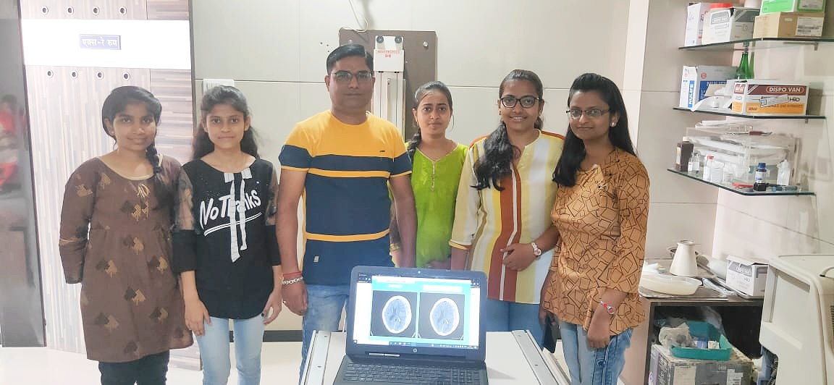
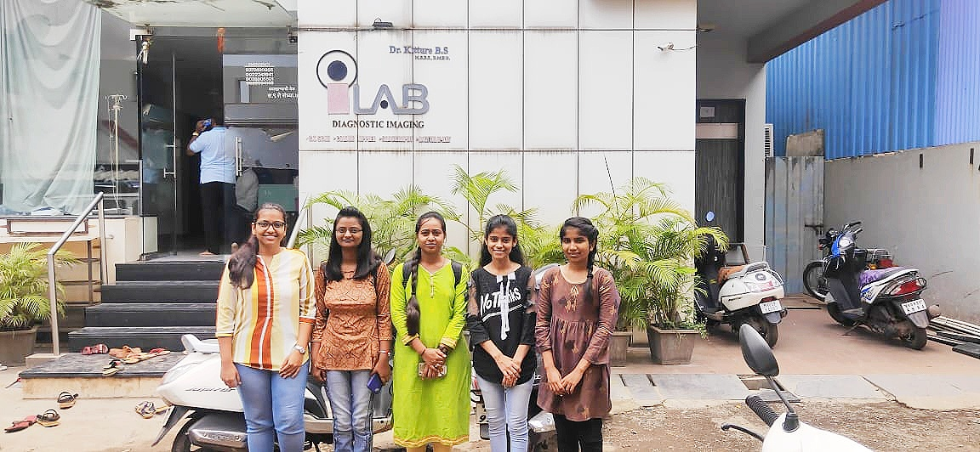
INDUSTRY GUIDANCE

Slide 35
REFERENCE
[1] V. L. Feigin et al., Update on the global burden of ischemic and hemorrhagic stroke in 1990-2013: The GBD 2013 study, vol. 45, no. 3. 2015.
[2] N. Venketasubramanian, B. W. Yoon, J. Pandian, and J. C. Navarro, Stroke Epidemiology in South, East, and South-East Asia: A Review, vol. 20, no. 1. 2018.
[3] G. A. P. Singh and P. K. Gupta, Performance analysis of various machine learning-based approaches for detection and classification of lung cancer in humans, vol. 3456789. Springer London, 2018.
[4] Tessy Badriyah, Nur Sakinah, Iwan Syarif, “Machine Learning Algorithm for Stroke Disease Classification” Proc. of the 2nd International Conference on Electrical, Communication and Computer Engineering (ICECCE) 12-13 June 2020, Istanbul, Turkey

Slide 36
REFERENCES
[5] Computer Methods and Programs in Biomedicine - Jae–woo Lee, Hyunsun Lim, Dong-wook Kim, Soon-ae Shin, Jinkwon Kim, Bora Yoo, Kyunghee Cho.
[6] Probability of Stroke: A Risk Profile from the Framingham Study - Philip A. Wolf, MD; Ralph B. D'Agostino, PhD, Albert J. Belanger, MA; and William B. Kannel, MD.
[7] Stroke prediction using artificial intelligence- M. Sheetal Singh, Prakash Choudhary.[IEEE Refernce Paper].

Slide 37
THANK YOU

Slide 38
Any Question..?

